Slide 1
430.211 Programming Methodology (프로그래밍 방법론)
Taesup Moon
Department of Electrical and Computer Engineering
Seoul National University

Slide 2
Outline
Chapter 5: Arrays

Slide 3
Ch 5. Arrays
Array definition:
A collection of data of a same type
Ex) storing 100 test scores
First "aggregate" data type we study
Means "grouping"
int,float,double,char are simple data types
Used for lists of similar items
Test scores, temperatures, names, etc.
Avoids declaring multiple simple variables
Can manipulate "list" as one entity

Slide 4
Declaring Arrays
Declare the array → allocates memory int score[5];
Declares array of 5 integers named "score"
Similar to declaring five variables: int score[0], score[1], score[2], score[3], score[4]
Array size must be a constant
Individual parts are called as :
Indexed or subscripted variables
"Elements" of the array
Value in brackets called index or subscript
Numbered from 0 to (size – 1)

Slide 5
Accessing Arrays
Access using index/subscript
cout << score[3];
Note two uses of brackets:
In declaration, specifies SIZE of array
Anywhere else, specifies a subscript
Subscript need not be literal
int score[MAX_SCORES];
score[n+1]=99;
If n is 2, identical to score[3]=99

Slide 6
Array Usage
Powerful storage mechanism
Can do commands like:
"Do this to i^{th} indexed variable” where i is computed by a program
"Display all elements of array score"
"Fill elements of array score from user input"
"Find highest value in array score"
"Find lowest value in array score"

Slide 7
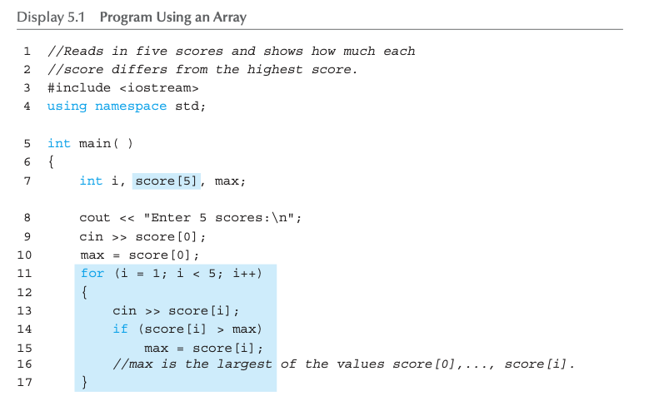
Array Program Example: Display 5.1 Program Using an Array (1 of 2)

Slide 8
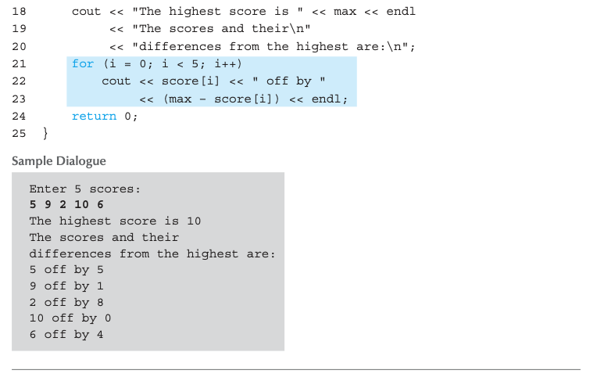
Array Program Example: Display 5.1 Program Using an Array (2 of 2)
For loop is ideally suited to cout through an array!

Slide 9
Major Array Pitfall
Array indexes always start with zero!
Zero is the "first" number to computer scientists
C++ will "let" you go beyond range
Unpredictable results
Compiler will not detect these errors!
Up to programmer to "stay in range"

Slide 10
Major Array Pitfall Example
Indexes range from 0 to (array_size – 1)
Example: int a[6]; // 6 is array size // Declares array of 6 int values called temperature
They are indexed as: a[0], a[1], … ,a[5]
Common mistake: a[6] = 5;
Index 6 is "out of range"!
No warning, possibly disastrous results (could have changed some other variable’s value)

Slide 11
Arrays in Memory
Recall simple variables:
Allocated memory in an "address"
Array declarations allocate memory for entire array
Sequentially-allocated
Means addresses allocated "back-to-back"
Allows indexing calculations
Simple "addition" from the array beginning (index 0)

Slide 12
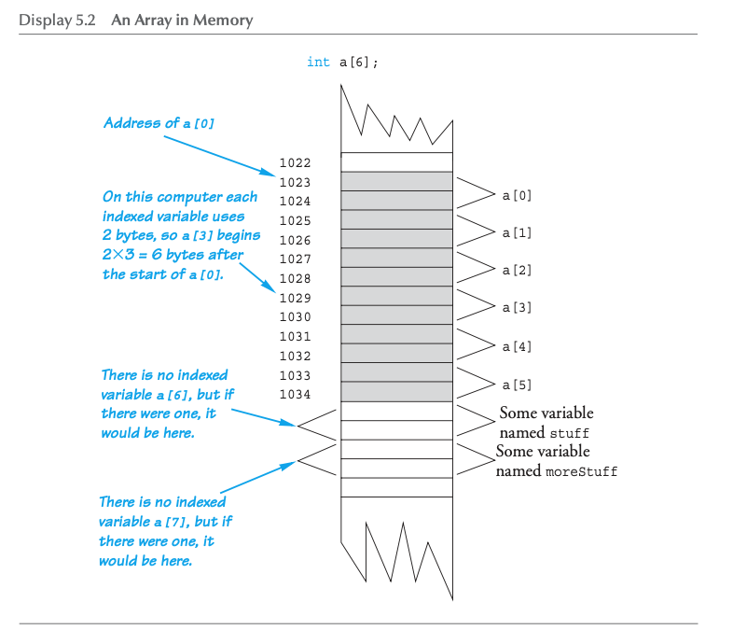
An Array in Memory

Slide 13

Defined Constant as Array Size
Can use defined/named constant for array size
Example: const int NUMBER_OF_STUDENTS = 5; int score[NUMBER_OF_STUDENTS];
Improves readability, versatility, and maintainability
What if we don’t know the total number of students?
Try not to do this way (use MAX upperbound)
In Ch.10, we will cover different kind of array whose size can be determined when the program is run (pointers)

Slide 14
Initializing Arrays
As simple variables can be initialized at declaration: int price = 0; // 0 is initial value
Arrays can as well: int children[3] = {2, 12, 1};
Equivalent to the following: int children[3]; children[0] = 2; children[1] = 12; children[2] = 1;

Slide 15
Auto-Initializing Arrays
If fewer values than array size are supplied:
Fills from the beginning
Fills the "rest" with zero of array base type
If array-size is left out
Declares array with size required based on the number of initialization values
Example: int b[] = {5, 12, 11};
Allocates array b to size 3
What’s the difference with int b[4] = {5, 12, 11};?

Slide 16
Arrays in Functions
As arguments to functions
Indexed variables
An individual "element" of an array can be a function parameter
Entire arrays
All array elements can be passed as "one entity"
As a return value of a function
Can be done (with a pointer) → Chapter 10

Slide 17
Indexed Variables as Arguments
Indexed variable is handled the same as a simple variable of array base type
Ex) given this function declaration: void myFunction(double par1);
And these declarations: int i; double n, a[10];
Can make these function calls: myFunction(i); // i is converted to double myFunction(a[3]); // a[3] is double myFunction(n); // n is double

Slide 18
Entire Arrays as Arguments
Formal parameter can be an entire array
In this case, the argument passed in a function call is the array name
Called "array parameter"
Send size of array as well
Typically done as the second parameter
Simple int type formal parameter

Slide 19
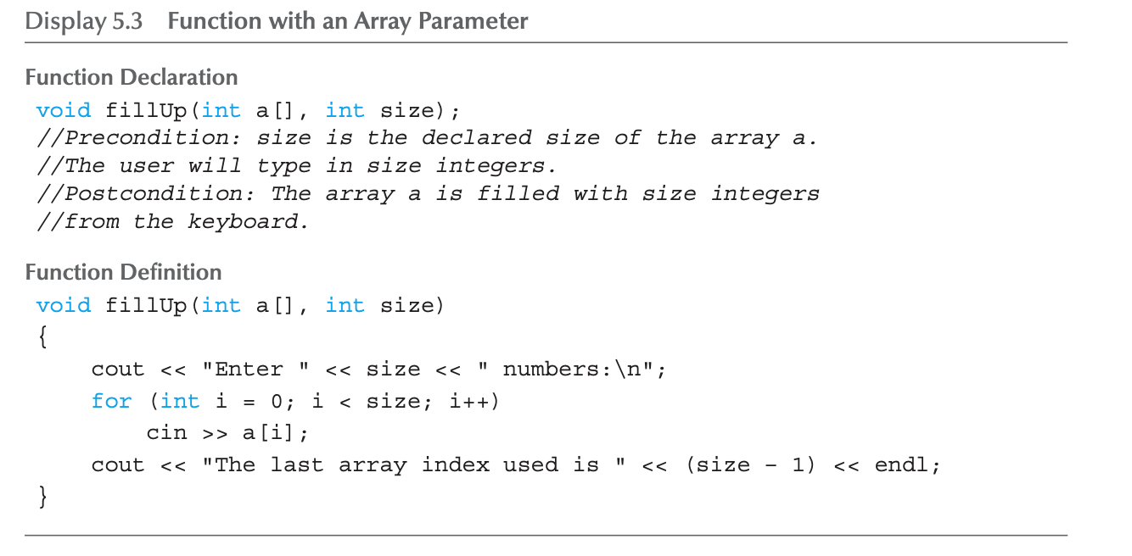
Entire Array as Argument Example: Display 5.3 Function with an Array Parameter
Formal array parameter
→ Not a call-by-reference parameter, but similar in some sense

Slide 20
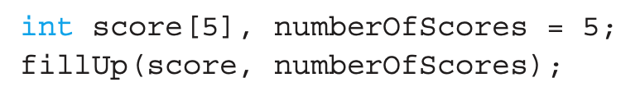
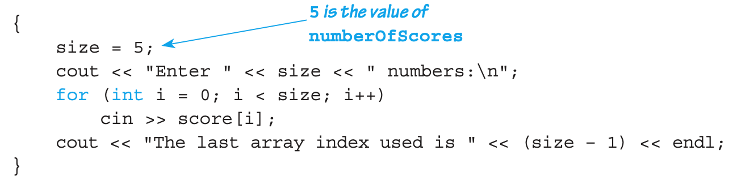
Entire Array as Argument Example
Continuing from the previous example
Suppose in the main() function definition, consider the call
1st argument is the entire array
2nd argument is indicating the size of the array
The function call is equivalent to
No bracket!
Formal parameter a is replaced with score!
→ Similar to call-by-reference!

Slide 21
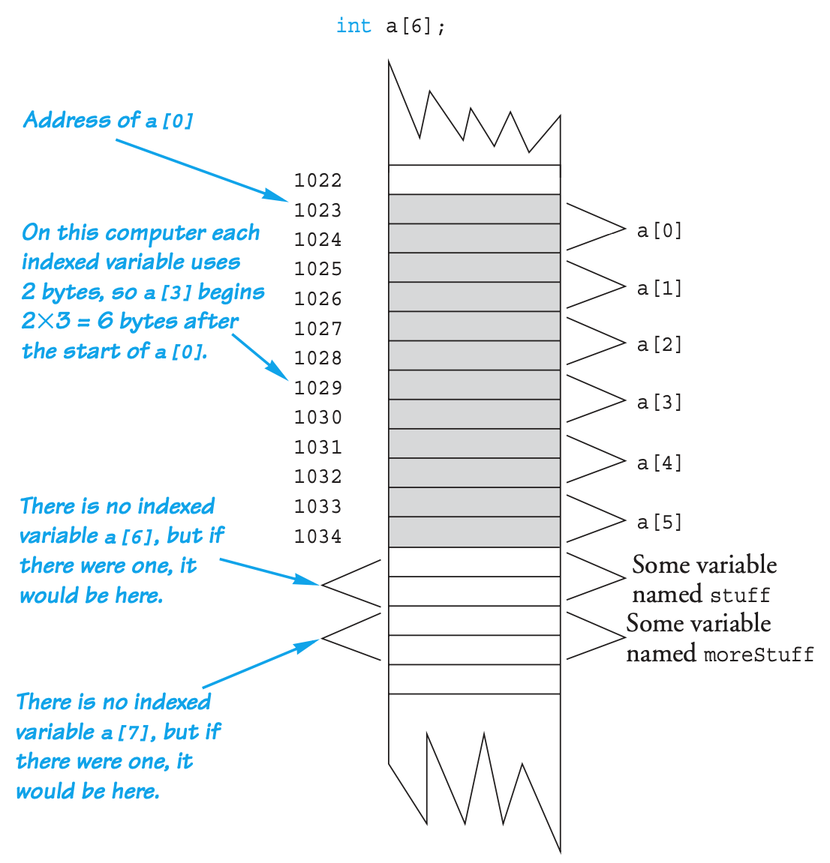
Array as Argument: How?
Again, recall the memory allocation for array
When score[5] is declared, the computer remembers only the address of score[0]
The address of the rest can be deduced
An array has three parts
The address of the first indexed variable
The base type of the array
The size of the array
When an array argument is used,
Only the first part is passed (base type matched!)
The size of the array is NOT passed

Slide 22


Array as Argument: How?
Thus, the size of the array must be passed!
Array parameter is a weak form of call-by-reference
Everything of array is told except for the size
Why such strange definition? (no bracket+size)
Can re-use the same function for any size of array
Sidenote
The array argument is passing the pointer to its first (zeroth) index variable (more in Ch. 10)

Slide 23
The const Parameter Modifier
Array parameter passes the address of 1st element
Similar to call-by-reference
Function can then modify array!
Often desirable, sometimes not!
To protect array contents from modification
Use "const" modifier before array parameter
Called "constant array parameter"
Tells compiler to "not allow" modifications

Slide 24
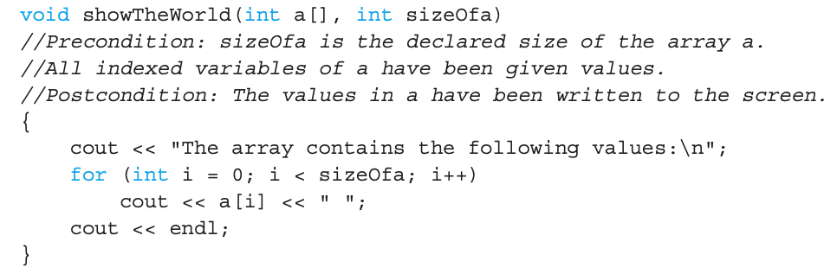
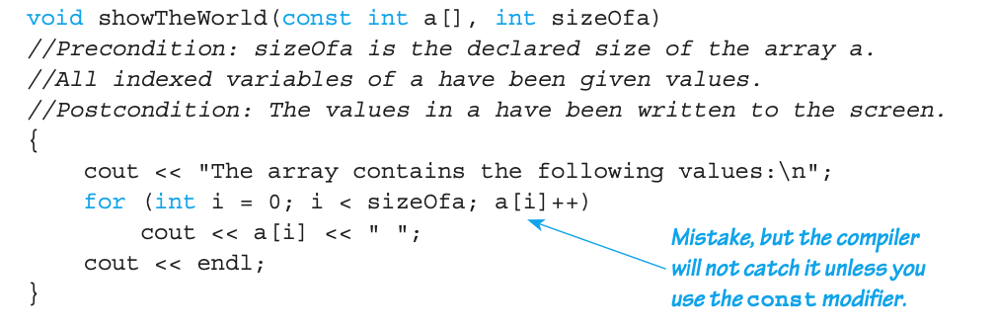
The const Parameter Modifier : Example
If const is not used, the function will result in an infinite loop! → safety check for preventing unwanted errors

Slide 25
Functions that Return an Array
Functions cannot return arrays the same way as simple types are returned
Requires use of a "pointer"
Will study in Chap.10.

Slide 26

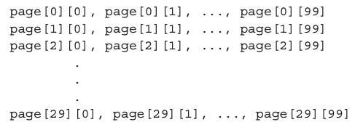
Multidimensional Arrays
Arrays with more than one index
Two indexes: An "array of arrays"
Visualize as:
A one-dimensional array of size 30, whose base type is a one-dimensional array of chars of size 100!
C++ allows any finite number of indexes

Slide 27
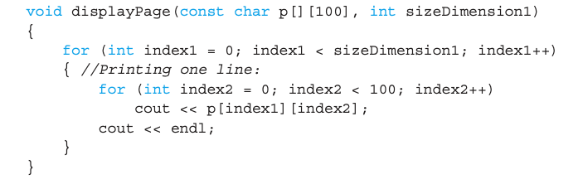
Multidimensional Array Function Parameters
Similar to one-dimensional array
1st dimension size is not given
Provided as second parameter
2nd dimension (3rd, 4th, …) sizes ARE given as constant
Part of description of the base type!
Example:
Then, call displayPage(page,30);

Slide 28
Summary 1
Array is collection of "same type" data
Indexed variables of array used just like any other simple variables
for-loop "natural" way to traverse arrays
Programmer responsible for staying "in bounds" of array
Array parameter is a "new" kind
Similar to call-by-reference

Slide 29
Summary 2
Array elements stored sequentially
"Contiguous" portion of memory
Only address of 1st element is passed to functions
Constant array parameters
Prevent modification of array contents
Multidimensional arrays
Create "array of arrays"

Slide 30
Thank you!
Web: http://mindlab-snu.github.io
E-mail: tsmoon@snu.ac.kr

